Slide 1
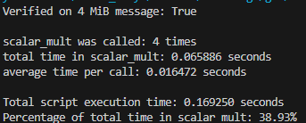
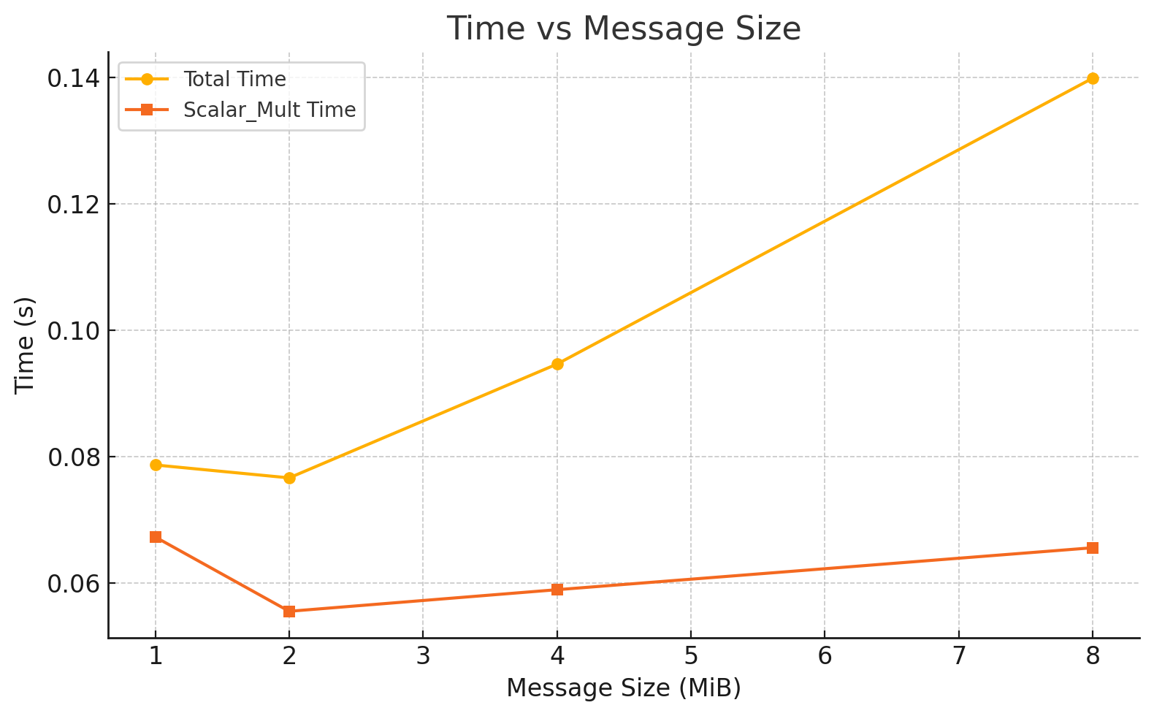
Elliptical Curve Digital Signature Algorithm Accelerator
What are you trying to do? I picked the core elliptic‐curve scalar‐multiplication operation (used in ECDSA) as the workload to accelerate
Others implemented and/or accelerated this algorithm?
Implemented a secp256k1 ECDSA core on Intel Cyclone IV, showing FPGA‐based signature verification 5×–10× faster than a CPU GPU frameworks (e.g., “gECC”) offer 5×–6× software speedups over CPU by parallelizing multi‐scalar operations on CUDA hardware
What am I trying to do?
By focusing on a cycle-accurate Verilog simulation (no processor overhead), we measure pure RTL cost and can rapidly explore different pipeline depths. Can Create a ECC specific Hardware Accelerator.
Accomplishments so far:
Ran pure-Python secp256k1 sign+verify on a 4 MB message, did profiling using cProfile + SnakeViz.
Built and functionally verified point-addition and point-doubling units in projective coordinates; matches Python outputs
Now Integrating using COCOTB
Hotspot For Acceleration (~40% of the time is consumed in Scalar Mult):
Scalar Multiplication
Modular Inversion
Point Addition

